Slide 1

St. Francis Institute of Technology Department of Computer Engineering
Sports Analysis and Outcome Prediction System
Group Members
Name of Student | Class-Roll No.
Darshan Salian | BE CMPN B-59
Saheel Sawant | BE CMPN B-62
Santosh Maurya | BE CMPN B-33
Under the guidance of
Mr. Shamsuddin Khan

Slide 2
Content
Introduction
Literature
Problem Statement with proposed solution
Work Flow of the system
Algorithms Used
Experimental Setup
Performance Evaluation Parameters
Validation with Test Cases
Results & Discussion
Conclusion
References

Slide 3
Introduction
Cricket and football fan base is massive and increasing rapidly day by day.
The current prediction systems are few in number and ignore distinctive parameters.
They do not provide a generalized platform for two or more sports.

Slide 4
Introduction
Our intended analysis and prediction system aims to be resourceful to news analysts, newspapers, websites where the odds can be used.
The points users will gain by the system’s prediction can be used for generating discounts on the other mainstream applications which in turn benefits users.

Slide 5
Literature Survey
In paper[1], the author uses logistic Regression to predict the outcome of a match.
The parameters used for the prediction are performance in previous games, current standings, venue, home and away performance, etc.
The accuracy of the system built was 58.41%.

Slide 6
Literature Survey
In paper[2] the author predicts the outcome of the matches using Bayesian Classifier.
The parameters used were home advantage, toss, batting first and day and night.
The accuracy of the system was 54%.

Slide 7
Literature Survey
In paper[3], the author predicts the outcome of matches using algorithms such as Naive Bayes, K Nearest Neighbours, ANN and Random Forest.
The features selected were current form of team, previous results between the team, no of injured players and average goals scored.
The software system was implemented in the Java programming language with use of Weka API.
The best accuracy was given by ANN with a accuracy of 68%.

Slide 8
Problem Statement
Current prediction systems are not generalised and do not consider relevant parameters. Thus, we intend to provide a platform for Cricket and Football wherein a tentative result will be predicted considering statistical parameters. The odds will be calculated using two machine learning algorithms for the same. Tournament standings, fixtures, news, trending videos will be also made available to the user.

Slide 9
Work Flow of the system
Select Sport
Sport Dashboard
Select Match
Enter required values
News
Rankings
Videos
Outcome
Prediction
Compare Prediction and Actual Result
By Algo. 01
By Algo. 02
Tournament Statistics

Slide 10
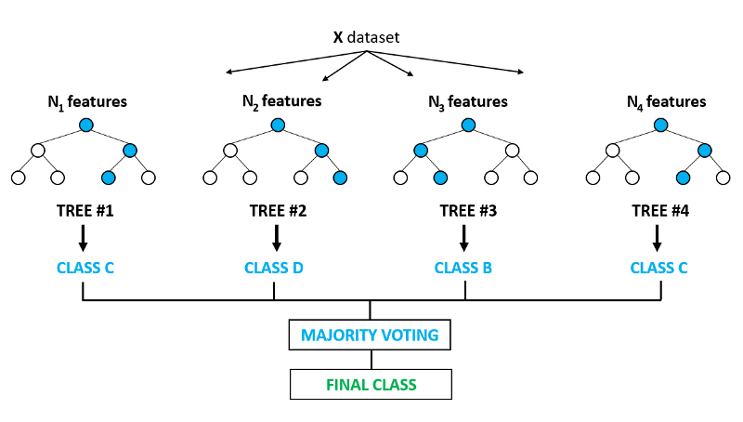
Algorithms Used: 1) Random Forest
Random Forest is a supervised learning algorithm which builds multiple decision trees and merges them together to get a more accurate and stable prediction.
The advantage of random forest is that it can be used for both classification and regression problems, which form the majority of current machine learning systems.

Slide 11
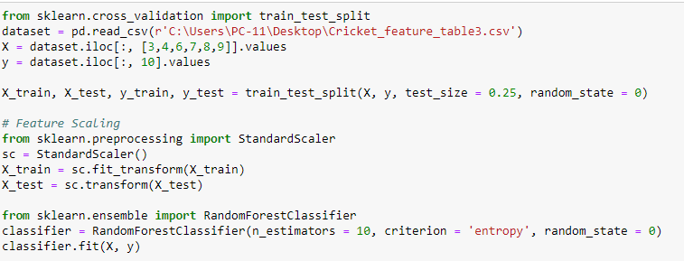
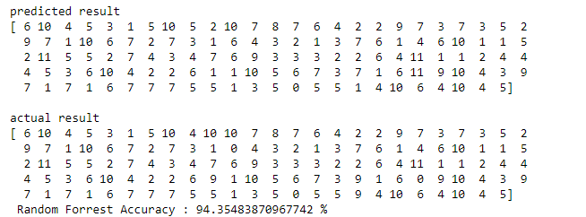
Random Forest Implementation

Slide 12
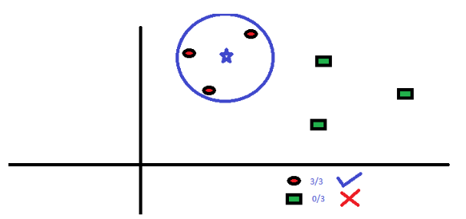
2) K Nearest Neighbours(KNN)
KNN is a supervised learning algorithm which is non-parametric , it means that it does not make any assumptions on the underlying data distribution.
The best choice of k depends upon the data; generally, larger values of k reduces effect of the noise on the classification,but make boundaries between classes less distinct.

Slide 13
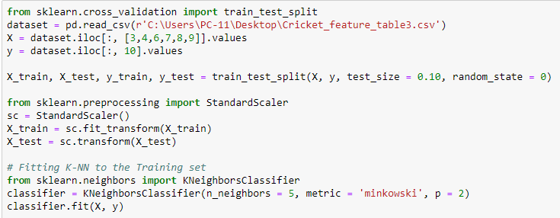
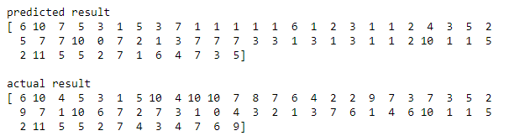
KNN Implementation

Slide 14
Accuracy of the Algorithms (Dataset)
 | Sports
Algorithm | Cricket | Football
Random Forest: | 67.32% | 62.37%
KNN | 58% | 67.11%

Slide 15
Experimental Setup
Scikit-learn: It is an open source library which features machine learning models to be used for prediction.
The cricket dataset is taken from Howstat.com whereas for football dataset is taken from Football.co.uk
The datasets are reliable, updated till date and are considered by many others for project purposes.

Slide 16
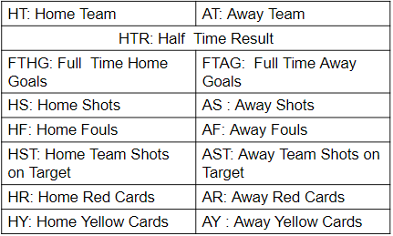
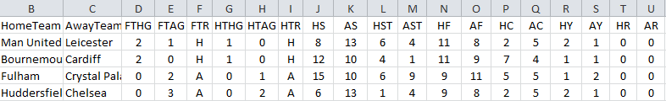
Performance Parameters for Football
30/4/2019

Slide 17
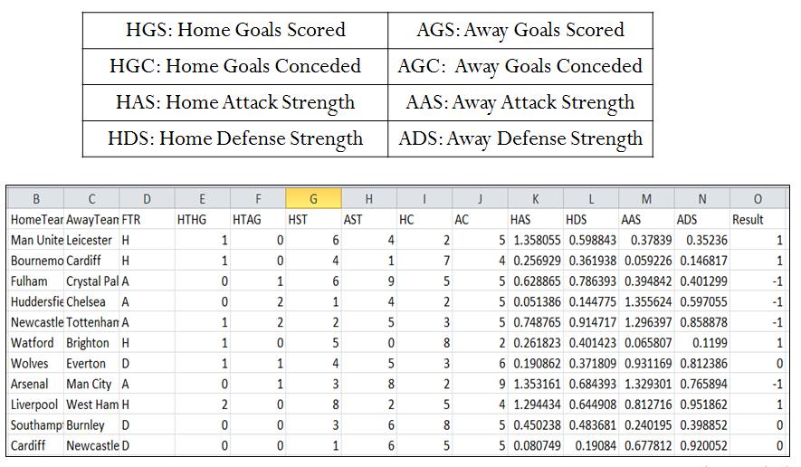
Derived parameters for Football
30/4/2019

Slide 18
Calculation of D.P. in Football
Avg_home_scored = Total no of goals scored by home team / Total no of Home matches
Avg_away_scored = Total no of goals scored by away team / Total no of Away matches
HGS = Total no of goals scored by home team
HGC = Total no of goals conceded by home team
AGS = Total no of goals scored by away team
AGC = Total no of goals conceded by away team
19 Home, 19 Away matches for each team each season and total 16 seasons: Total 304 matches
HAS = (HGS / 304.0) / avg_home_scored
.AAS = (AGS / 304.0) / avg_away_scored
HDS = (HGC / 304.0) / avg_home_conceded
ADS = (AGC / 304.0) / avg_away_conceded
30/4/2019

Slide 19
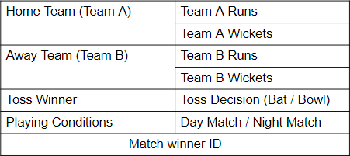
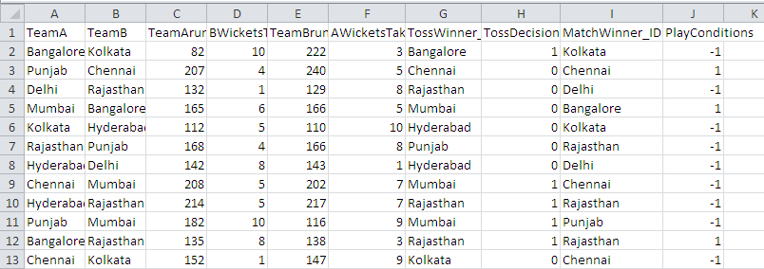
Performance parameters for Cricket
30/4/2019

Slide 20
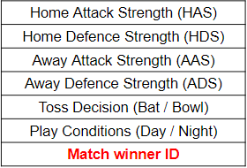
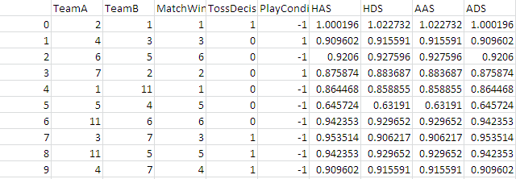
Derived parameters (D.P.) for Cricket
30/4/2019

Slide 21
Calculation of D.P. in Cricket
Avg_home_runs = Total runs scored by TeamA / total no of Home matches
Avg_away_scored = Total runs scored by TeamB / total no of Away matches
HRS= Total runs scored by TeamA
HRC = Total runs conceded by TeamB
ARS = Total runs scored by TeamB
ARC = Total runs conceded by TeamA
8 Home matches for each team each season and 11 seasons therefore 88 home matches and 88 away matches
HAS = (HRS / 80.0) / avg_home_runs
AAS = (ARS / 80.0) / avg_away_runs
HDS = (HRC / 80.0) / avg_home_conceded
ADS = (ARC / 80.0) / avg_away_conceded

Slide 22
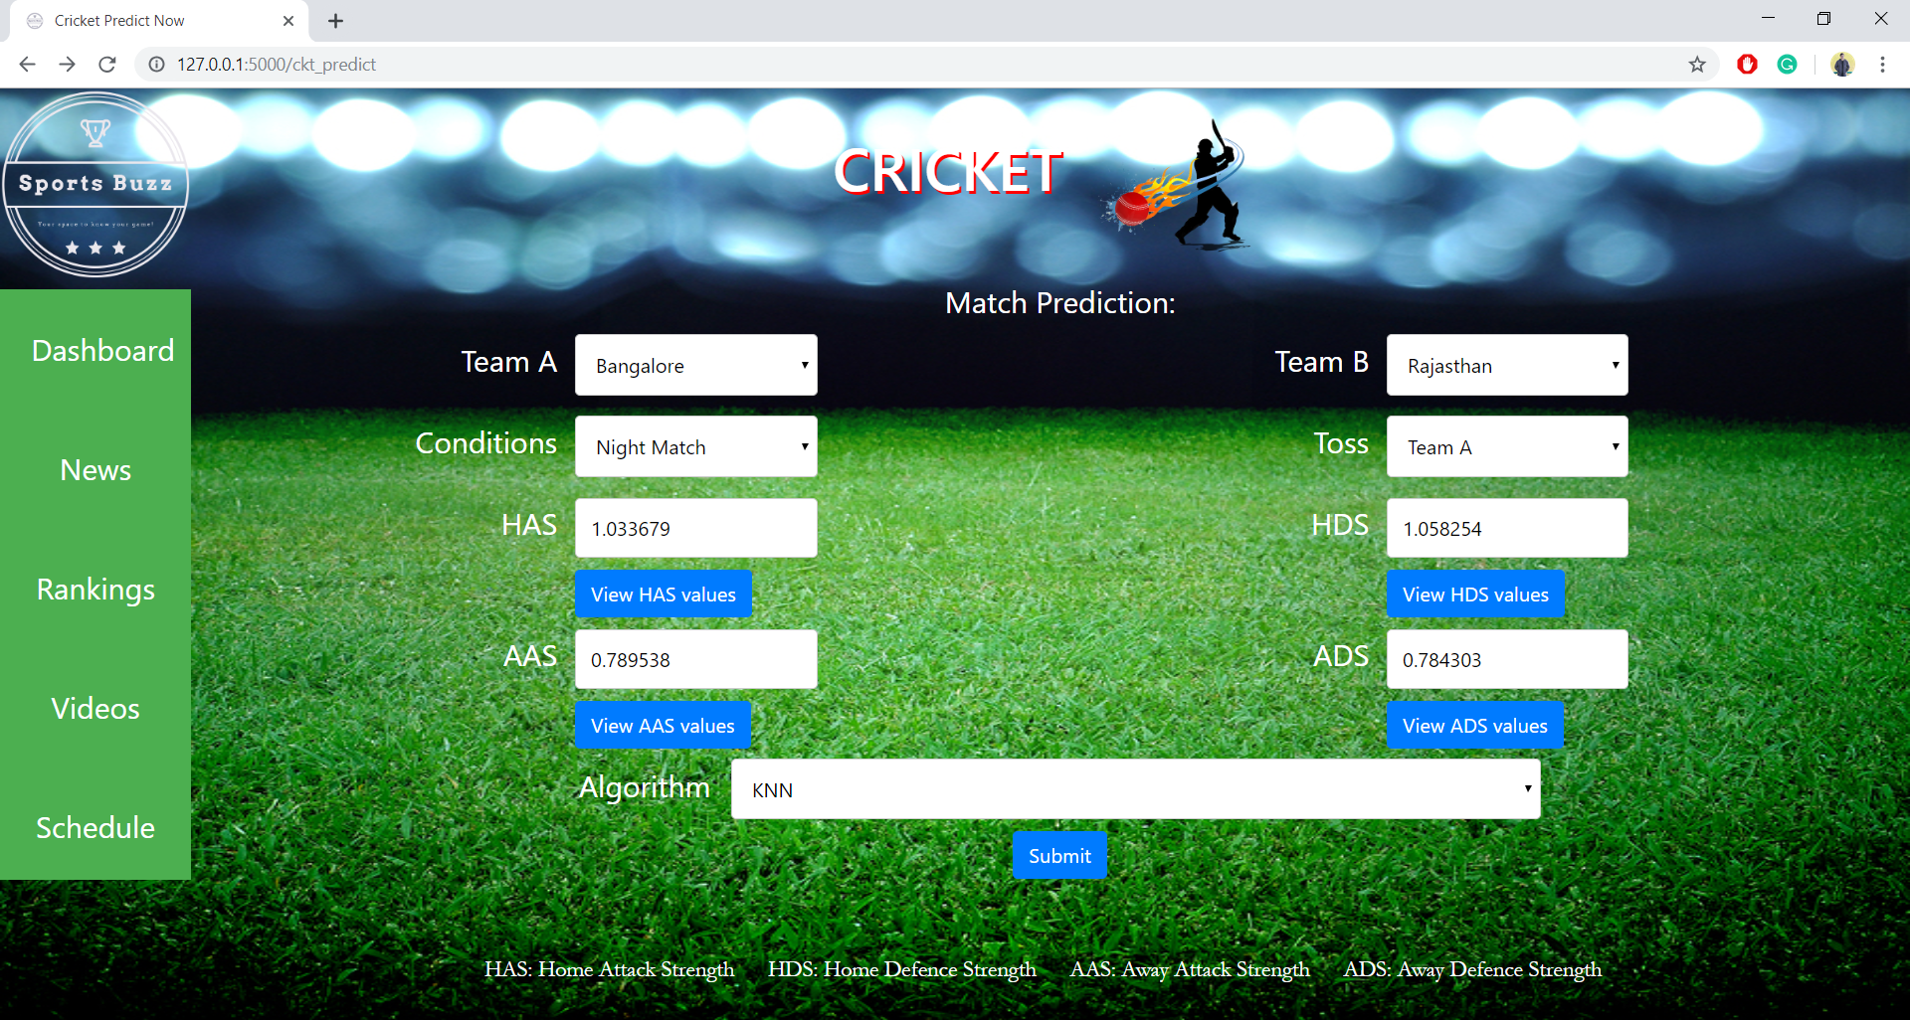
Validation with Test cases
Here, users enter values for all the given parameters to check the outcome.

Slide 23
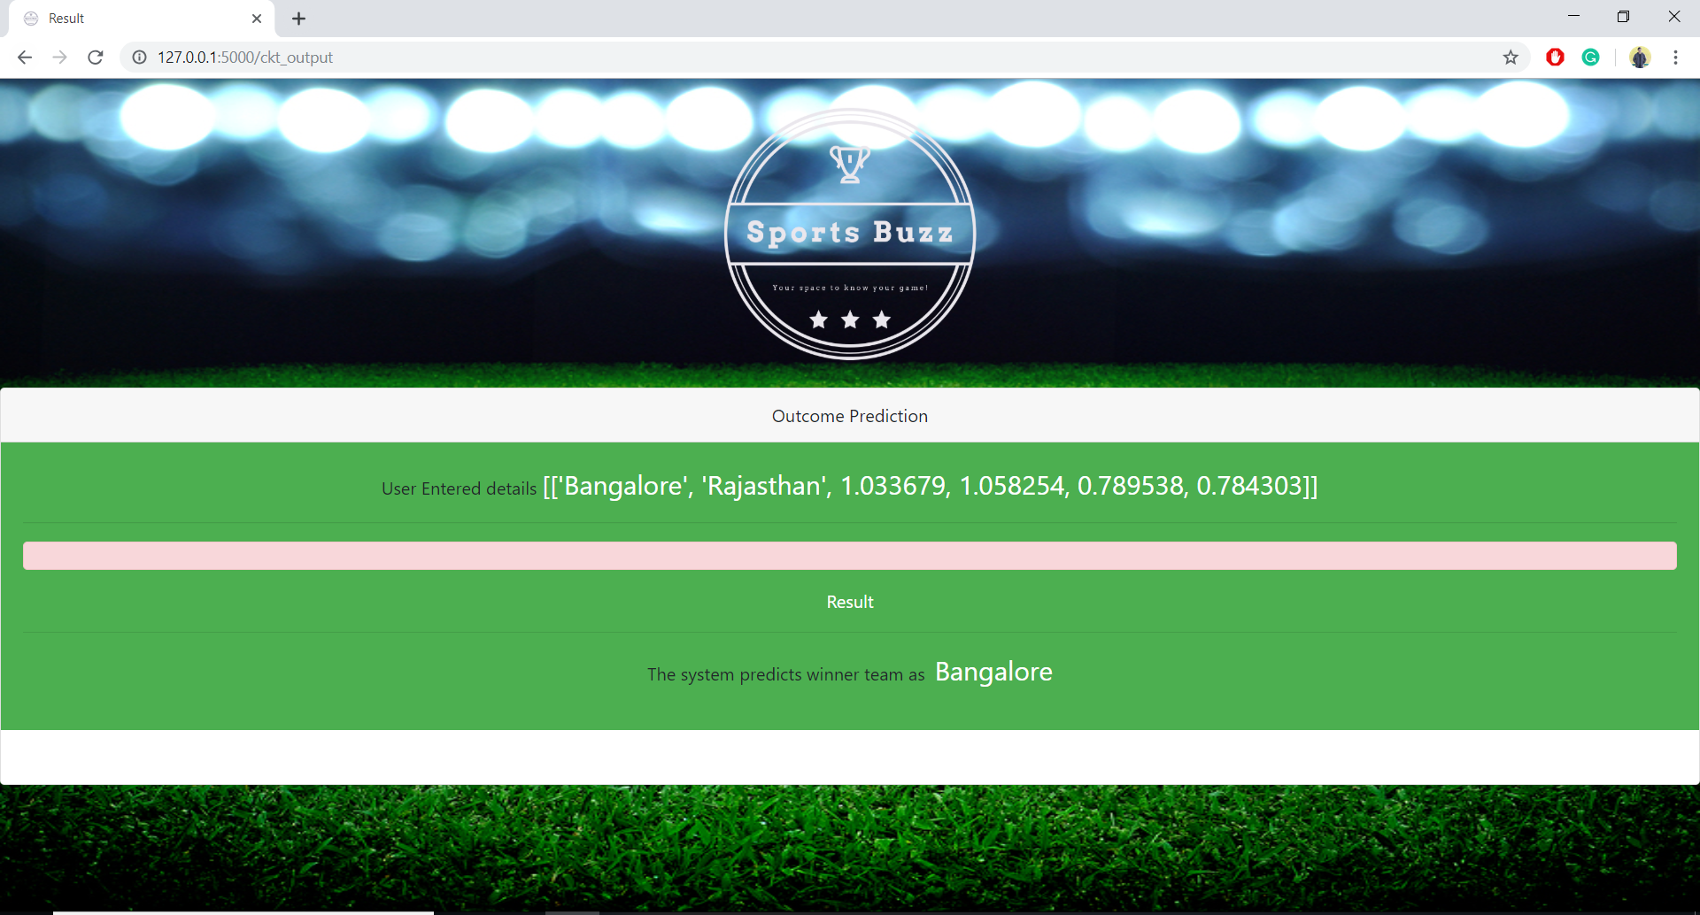
Results and Discussions
After processing the inputs in trained model, we get the name of winner team on the interface.

Slide 24
Conclusion
Using machine learning algorithms based on supervised learning approach, an outcome will be predicted for both Cricket and Football based on the respective sports relevant parameters and along with this users can also access other essential supplementary features.

Slide 25
References
D. Prasetio and D. Harlili, “Predicting football match results with logistic regression,” 2016 International Conference On Advanced Informatics: Concepts, Theory And Application (ICAICTA), 2016.
S. Dobravec, “Predicting sports results using latent features: A case study,” 2015 38th International Convention on Information and Communication Technology, Electronics and Microelectronics (MIPRO), 2015.
A. Joseph, N. Fenton, and M. Neil, “Predicting football results using Bayesian nets and other machine learning techniques,” Knowledge-Based Systems, vol. 19, no. 7, pp. 544–553, 2006.
Alan McCabe and Jarrod Trevathan -‘Artificial Intelligence in Sports Prediction’-Fifth International Conference on Information Technology (2008) New Generations.
Ghada Soliman, Ala'a El-Nabawy, Ahmed Misbah, Seif Eldawlatly - ‘Predicting all star player in the national basketball association using random forest’- Intelligent Systems Conference IntelliSys 2017.

